Slide 1

unmithy
HOME
SERVICES
TEAM
CONTACT
Looking for support with
flexible operations?
on-demand leadership?
advanced analytics and insights?
We help you with access to skilled professionals and tools using our innovative talent virtualization model

Slide 2
Our Fundamental Principles
Collaborative consumption as a strategy to transforming operations and business
Unique confluence of capabilities in strategy, operations, digital, and analytics
Outcome focused agile engagement with consulting charges aligned to tangible value

Slide 3
Our Services
Flexible and Efficient
Delivery Centres
Workshops and
Trainings
Advisory and Leadership Support
Transformation
Consulting
An innovative and highly flexible center of excellence for delivering various services, including:
Application development and support
Data and analytics, MIS etc.
Industry research and reports
Technology and operations support
Outcome oriented interventions like:
Design and Innovation workshops
Problem solving workshops
Change management trainings and support
Lean Six Sigma trainings
Agile implementation support
Provide on-demand advisory and leadership support in areas:
Digital strategy, Data sciences, Technology development, Operations and delivery management
Transformation programs
Interim staffing of leadership roles
Consulting services by highly experienced professionals in the areas of
Business model design and optimization
Product / services performance
Opportunity identification and improvements
VALUE TO OUR CLIENTS:
COE As A Service
Virtual COE without Scale or Large Investment or Long-term Commitment
Flexible Engagement Options
VALUE TO OUR CLIENTS:
Solution Design Workshops with Outcome Focus
On-going Mentoring and Support
VALUE TO OUR CLIENTS:
Virtual and Part-time Staffing of Leadership Roles
On-demand Skills
Virtual BOD for SMBs
Independent Review and Validation of Strategies and Execution Plans
VALUE TO OUR CLIENTS:
Business Case Development and Validation
Transformation Programs Design using Advanced Tools and Techniques
Program Execution with Ownership for Value Delivery
Access to High Quality SME Support

Slide 4
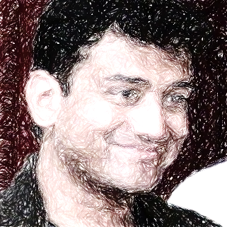
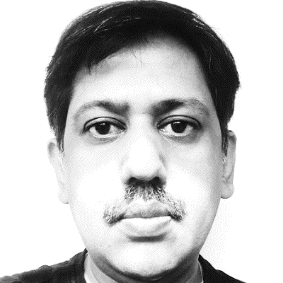
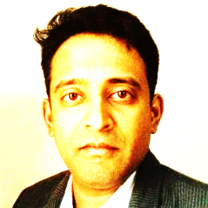
Our Team
Linkedin:
https://www.linkedin.com/in/chandra11/
Twitter:
https://twitter.com/_kchandra
Chandra Kallakuri
Co-founder
Transformations | Operations | Research
Vish Ramdas
Co-founder
Digital | Transformations | Data Science
Milind Mahadik
Data Science | Architecture
20+ years of experience in delivering high-impact initiatives in manufacturing, technology, and business operations.
Exposure to multiple industries including financial services, automotive, technology products, digital commerce, and telecom.
Focus areas include operations strategy and transformation, delivery model design, process simplification and performance, new product programs, analytics and insights, workforce management, portfolio management, project valuations, and customer experience.
18Y experience in Insurance, Tech, Pharma & MFG . Ran 300+ 15Mn USD GIC for AIG Ran 15Mn USD Insurance SMAC practice @Wipro
Innovation led transformation through Digital, Big Data Analytics. consulted for Strategy, Lean, Agile, Product Mgmt, ITSM. Founded 2 start-ups Techvoyant and Outdu and has received 3 PCT patents for Business Tech Innovation
Architect and data science professional with 15 years of experience working for organizations like AIG, Fedex, VMWare and Iron Mountain.
Proven track record in delivering new product in Marketing Analytics, Lead Generation, Stock Portfolio Analysis and Telecom Billing. Help establish two successful startups by delivering version 1.0 of their products.
Milinds work includes PDF Vectorization Platform,
Automated Sumyag Data Explorer Platform, Lead recommendation engine for marketing and sales for a successful startup, data science model operationalization platform at AIG
Linkedin:
https://www.linkedin.com/in/viramdas/
Twitter:
https://twitter.com/gopu44

Slide 5
Our Network of Experts
(after consent from them)
 | Manish [ Org Change] Manish brings 20+ years of experience in Agile, Lean transformation having worked with WIPRO and other organizations. Consults on Self Development workshops, Change Management, Disruptive innovation | Sudip [Digital – Java] 21 Yrs. Of experience in Management Consulting, Delivery and Innovation expertise. Proficiency in Retail, Airlines, Hospitality and Capital Markets. Consults Strategy, Optimizations, Product Management and Digital Transformation. Aims at bringing value driven innovation and transformation through Digital and emerging technologies.
Sanjay [ Process Change] 18 Yrs. of experience in IT consulting, ITIL implementation, program management, transition management, and quality assurance. Worked in Defense, BFSI, Auto, and Energy & Climate Change areas. Consulted CIOs and CXOs on IT operations and business service management. Graduate in Mechanical Engineering. | Sandeep [Process Change ] 12 Yrs. of experience in developing and implementing value based strategic initiatives in various industries to improve human and process performance. Played COO role in e-commerce and IP licensing industries. Post Graduate in Management with graduation in Engineering. | Venkat [ IO T – Firmware ] 21 years experience in deep embedded and firmware engineering for hardware and electronics solutions for IOT and industrial purposes. Venkat has worked as the Lead product engineering at Ingersoll Rand for the past 13 years. Venkat has been a technology evangelist and consults on Agile, Product Innovation, IoT – Technology Strategy, Coaching

Slide 6
Other Information
Linkedin Page of Unmithy:
https://www.linkedin.com/company/13287353/
Twitter:
https://twitter.com/unmithy
Email address for contact us:
Info@unmithy.com
© 2017 Unmithy Innoservices, All Rights Reserved | Terms | Privacy Policy

